Slide 1
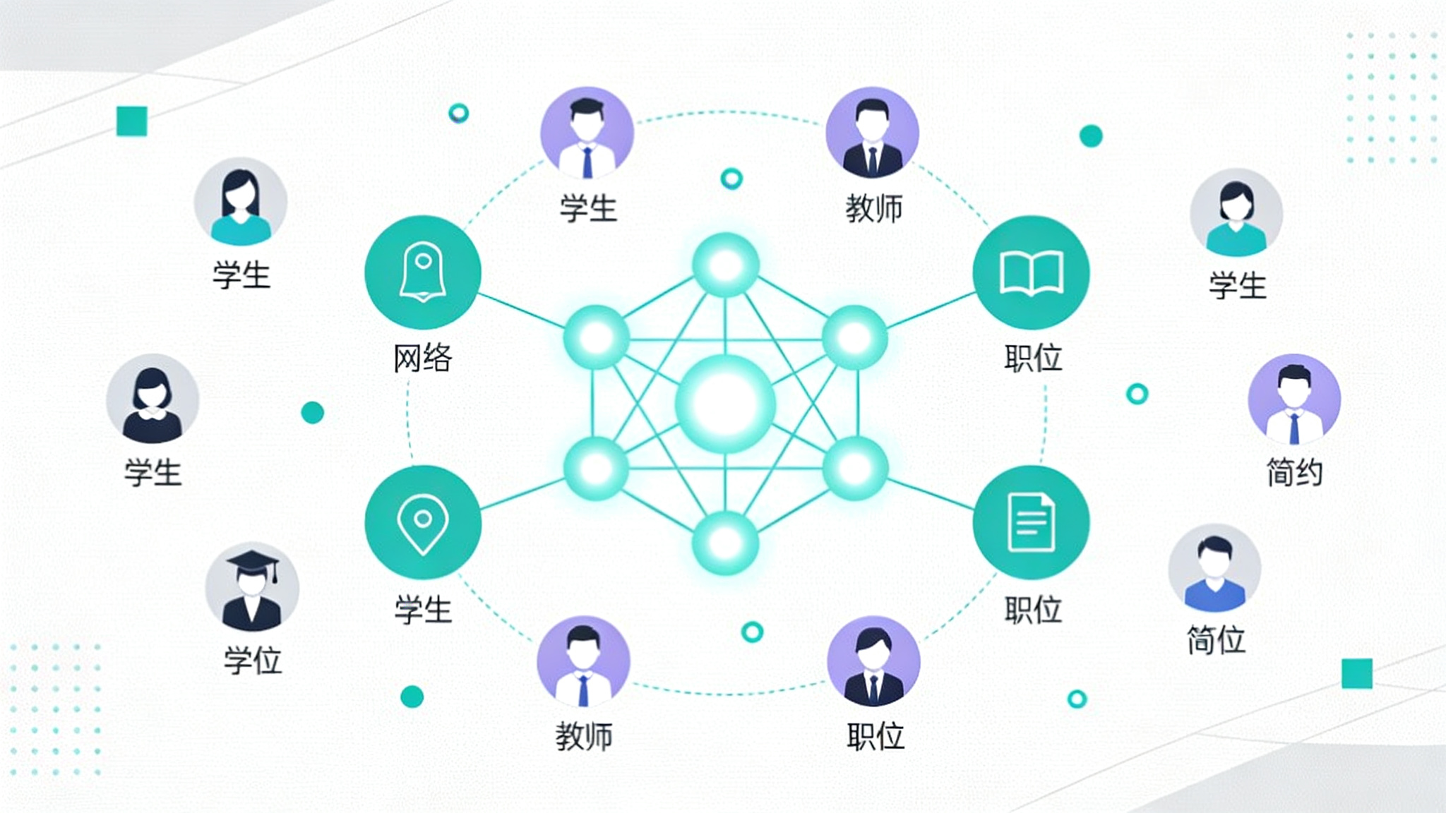

TA Recruitment System
Prototype Showcase
Notes:
大家好，今天我将向大家展示我们团队为北京邮电大学国际学院设计的助教招聘系统。这个项目旨在通过数字化手段，解决传统助教招聘流程中效率低下、管理困难的痛点。本次展示将从项目概述、系统功能、原型设计、技术选型、开发流程以及未来展望六个方面，全面解析我们的设计理念和实现方案。希望通过这次分享，能让大家对我们的项目有一个清晰而深入的了解。

Slide 2
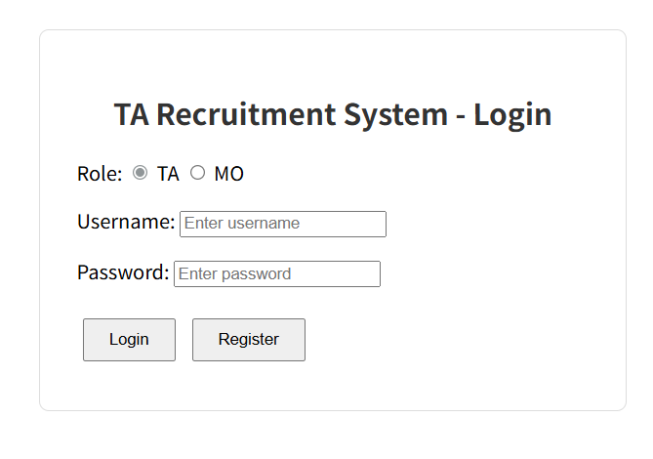
Login Page
The login page provides a clear role selection to ensure that TAs and MOs can access the correct interface. The registration page only requires the most basic information, allowing new users to quickly complete account creation.

Slide 3
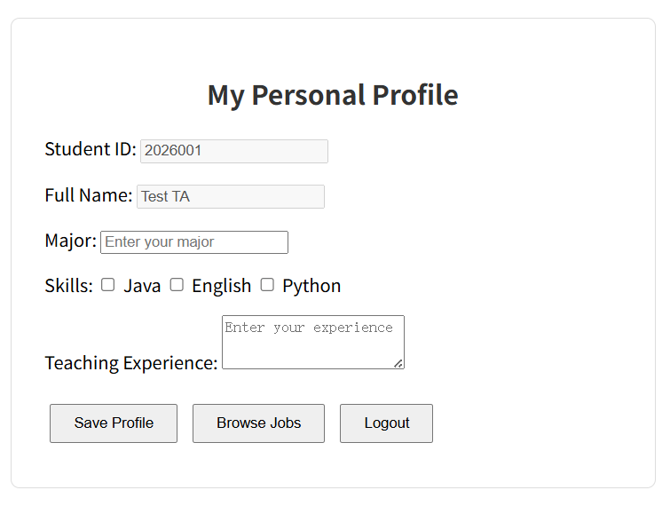
Personal Profile Page
After logging in, the user will enter their profile page. Here, they can improve their skills and experience. The page is clearly designed, and the operation buttons are clear.

Slide 4
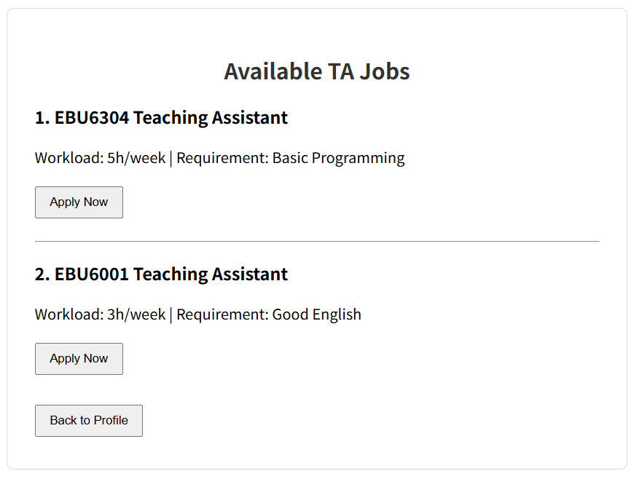
Job Browing Page
From the profile page, users can easily navigate to the job listings page. The job listings page uses a card-style design, with information clearly visible, and a prominent 'Apply' button guides users to take the next step.

Slide 5
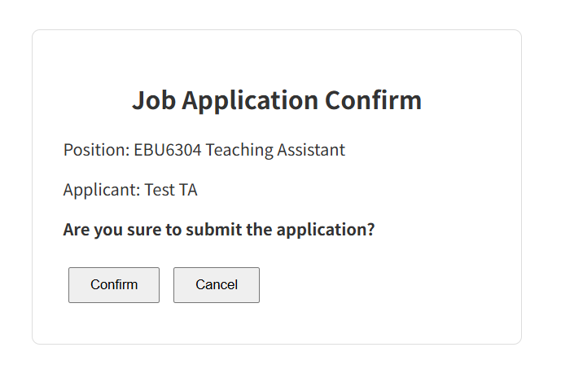
Job Application Page
The final step is the application confirmation page. When the user clicks 'Apply,' the system will display a confirmation pop-up, clearly listing the applicant and the position applied for, and asking the user to confirm the submission. This design is intended to prevent users from applying for the wrong position due to accidental operations.

